Slide 1

Big Mountain Resort
Project Report
By Abhiram Muktineni

Slide 2
Problem Identification
Problem Statement: In a recent effort to increase the distribution of visitors, Big Mountain Resort has installed an additional chairlift which increased its operating costs by $1.54M for this season. To offset this rise in operating costs, the resort will have to make changes in its ticket pricing strategy, also consider either cutting other operating costs without undermining the ticket price or that will support an even higher ticket price, all by October 31st 2020.
Objective: Restructure ticket price, explore options to cut down operating costs and increase profitability.
Data Source: ski_resort_data.csv, a CSV file obtained from the Database Manager.
Target Feature: Ticket Price

Slide 3
Recommendations and Key Findings
Based on the of market data from 330 Big Mountain Resort’s closest competitors across the US, we identified that the current day pass ticket price is under-priced.
Our model revealed that the current market will bear price increases from $81 to $94.22 (+/- $10.39), i.e. anywhere between $83.83 and $104.61.
This would lead to an annual revenue increase between $4.952M ($2.83/day/ticket) and $41.317M ($23.61/day/ticket) assuming 350,000 customers purchased 5 day passes.
Of all the features, there were key features that came up as important in modelling and impacted the ticket prices the most: Fast Quads, Runs, Snow-Making and Vertical Drop. We used these features as the basis for analysis for capital investment and recommendations for next steps.
Increase the ticket price to the minimum recommended by the study, from current $81 to $83.83 per day per ticket. On a daily basis a revenue increase of 2.3%(83.83/81) should result and could be validated against recent sales info.

Slide 4
Recommendations and Key Findings
Eventually increase the ticket price to a maximum of $104.61 based on the positive results obtained above.
Close one run from current runs available by selecting the least travelled or least popular run. This should not impact the results predicted in the above steps. The below model says there would be no impact in revenue for closing one least popular run. However, closing multiple runs successively reduces support for ticket price and so revenue resulting into a loss. You can consider operating this run only when there is an increase in demand. Meanwhile, the operating costs saved during off days can be added to the resort’s savings. (Refer fig in the next slide).
As described above some of the key features which had great impact on the ticket price were Runs, Snow Making and Vertical Drop. Based on our model, adding a run, increasing the vertical drop by 150 feet, and installing an additional chair lift increases support for ticket price by $1.99 this in turn could lead to an increase in revenue by about $3.48M per season. These additions justify and offset the $1.54M increase in resort’s operational cost and brings in profit of $1.94M above that amount.
Adding 2 acres of snow making to the above changes will make no difference, still leaving increase in ticket price by $1.99 and annual revenue increase to $3.48M. But, adding more snow making might attract a few more visitors which might eventually increase the overall revenue.

Slide 5
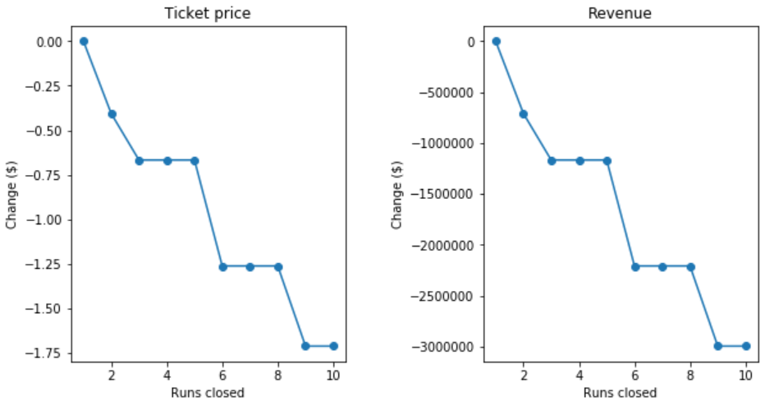
Recommendations and Key Findings

Slide 6
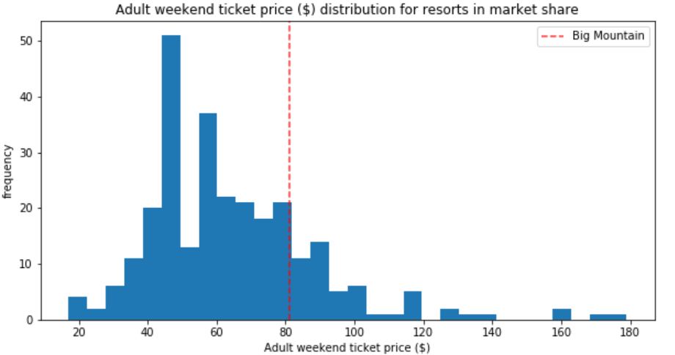
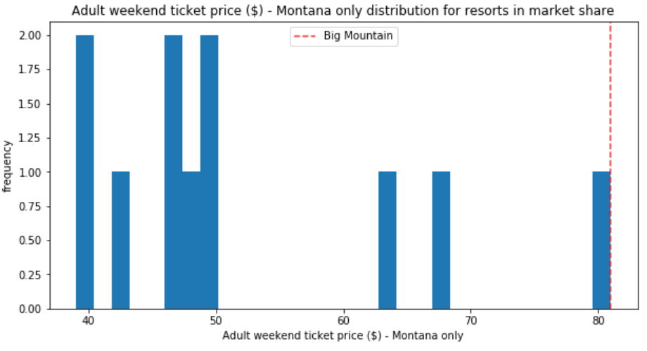
Modeling and Analysis (Ticket Prices)

Slide 7
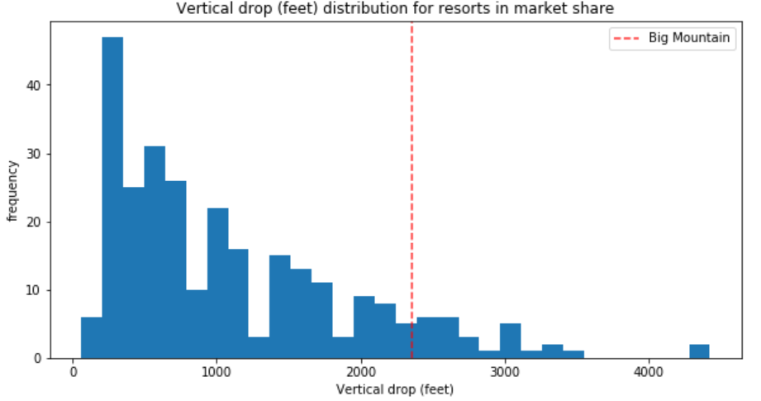
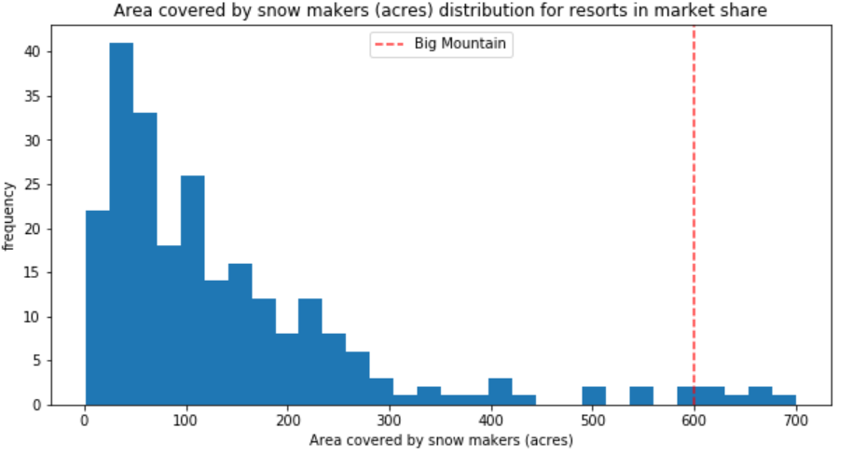
Modeling and Analysis (Vertical Drop & Snow Making Area)

Slide 8
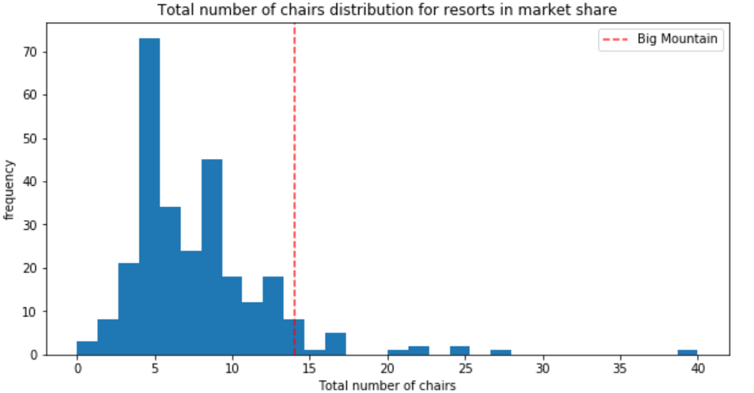
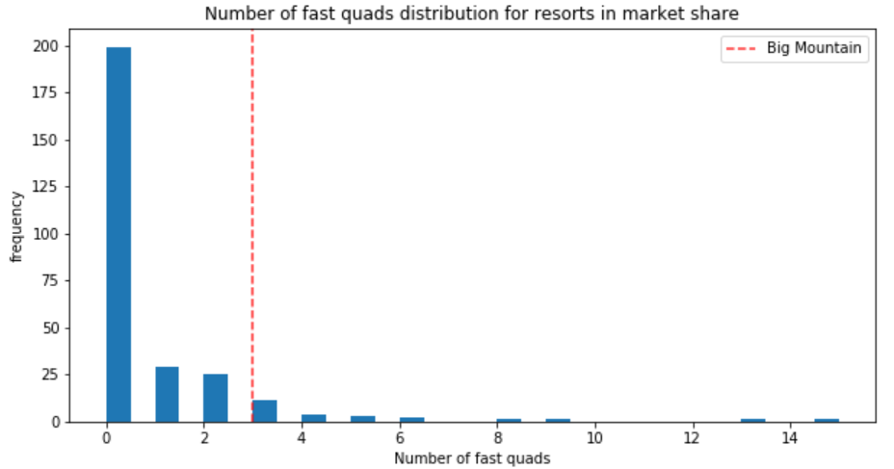
Modeling and Analysis (No. of Chairs & Fast Quads)

Slide 9
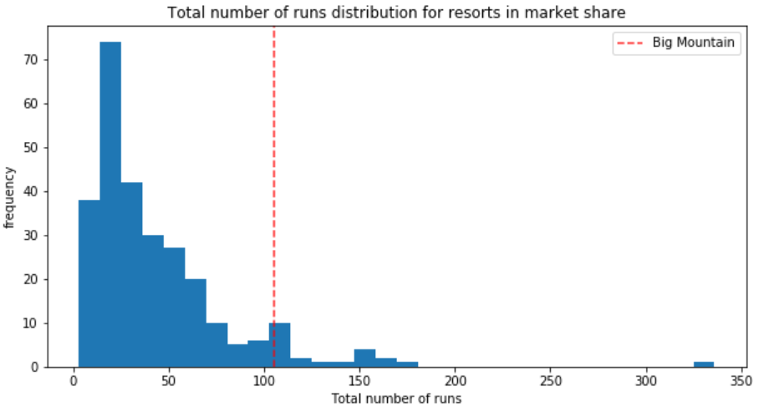
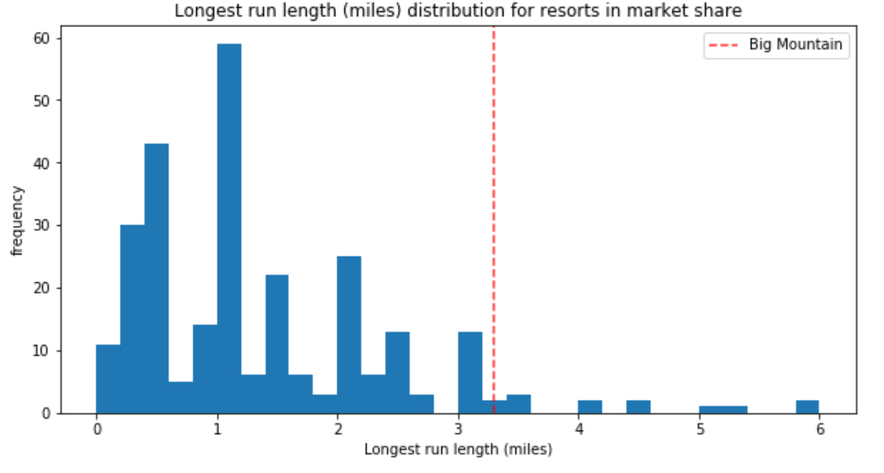
Modeling and Analysis (Runs)

Slide 10
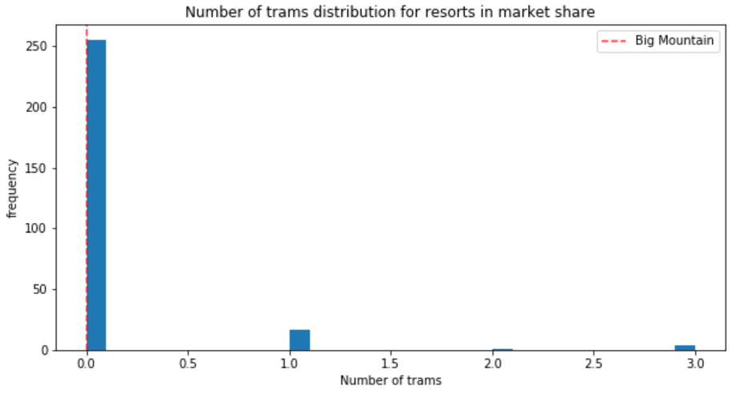
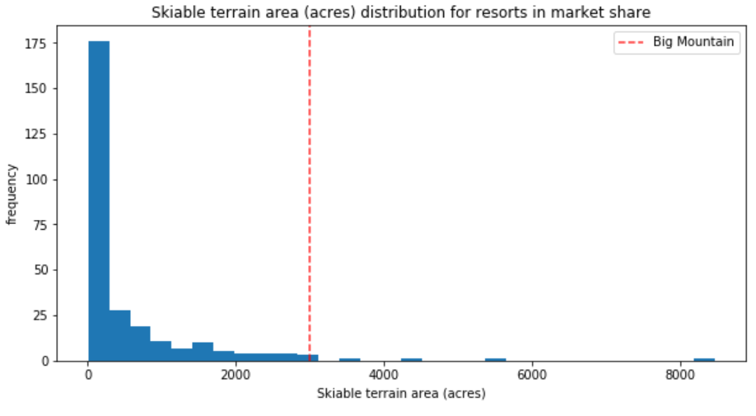
Modeling and Analysis (Trams & Skiable Terrain area)

Slide 11
Summary & Conclusion
BMR should start increasing the ticket prices in a stepwise manner from anywhere between (to begin with) minimum of $83.83 and eventually to maximum of $104.61 which results in an increase in revenue from anywhere between $4.95M and $41.32M respectively.
Adding a run, increasing vertical drop by 150 ft and adding a chairlift results in an increase in annual revenue.
Closure of least used runs in order to reduce the operational costs.
Analysis performed in this study is not limited further analysis if needed can also be done to achieve more results.

Slide 12


